Slide 1

Numerical analysis of protected qubits​
TR CONTROL: ​ ​ Gabriel Vandersippe,​ Eliot Delachaux
Source : IBM (via The Quantum Insider)
1

Slide 2
Outline
Brief introduction to superconducting circuits
Project Motivations
Results with Krylov techniques (Eliot)
Results with Tensor Networks (Gabriel)
Using Python packages : NumPy, QuTiP, SCQubits, MatPlotLib, SciPy, JAX, Pandas
Using Julia packages :
ITensors, ITensorMPS, KrylovKit, CairoMakie, LinearAlgebra, HypergeometricFunctions, CSV, DataFrames
2

Slide 3
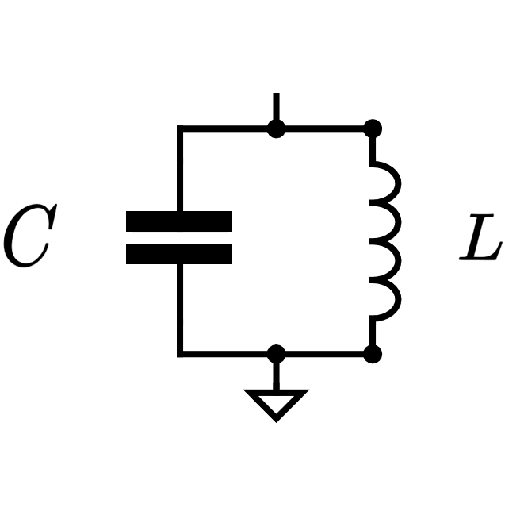
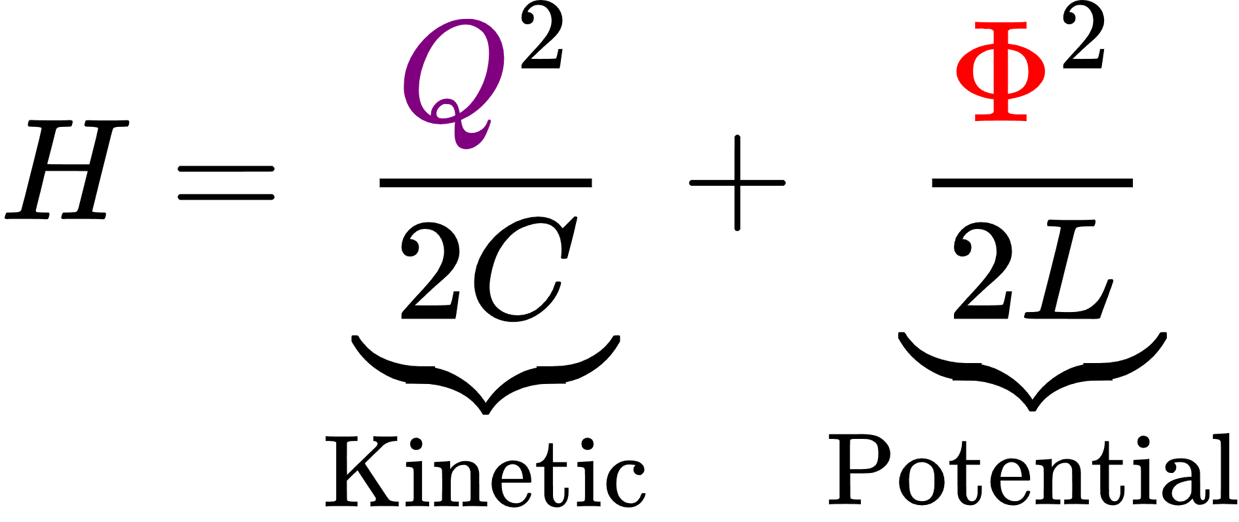
Introduction : Harmonic Oscillator
3
Blais, et al., Reviews of Modern Physics 93 (2), 025005 (2021)

Slide 4
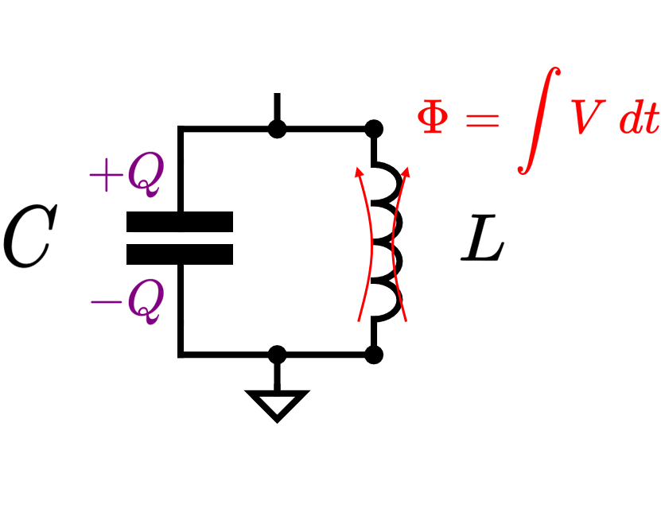
Introduction : Harmonic Oscillator
4
Blais, et al., Reviews of Modern Physics 93 (2), 025005 (2021)

Slide 5
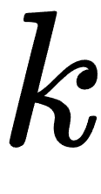
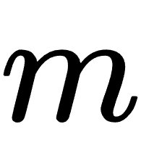
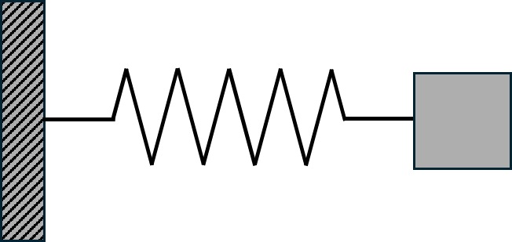
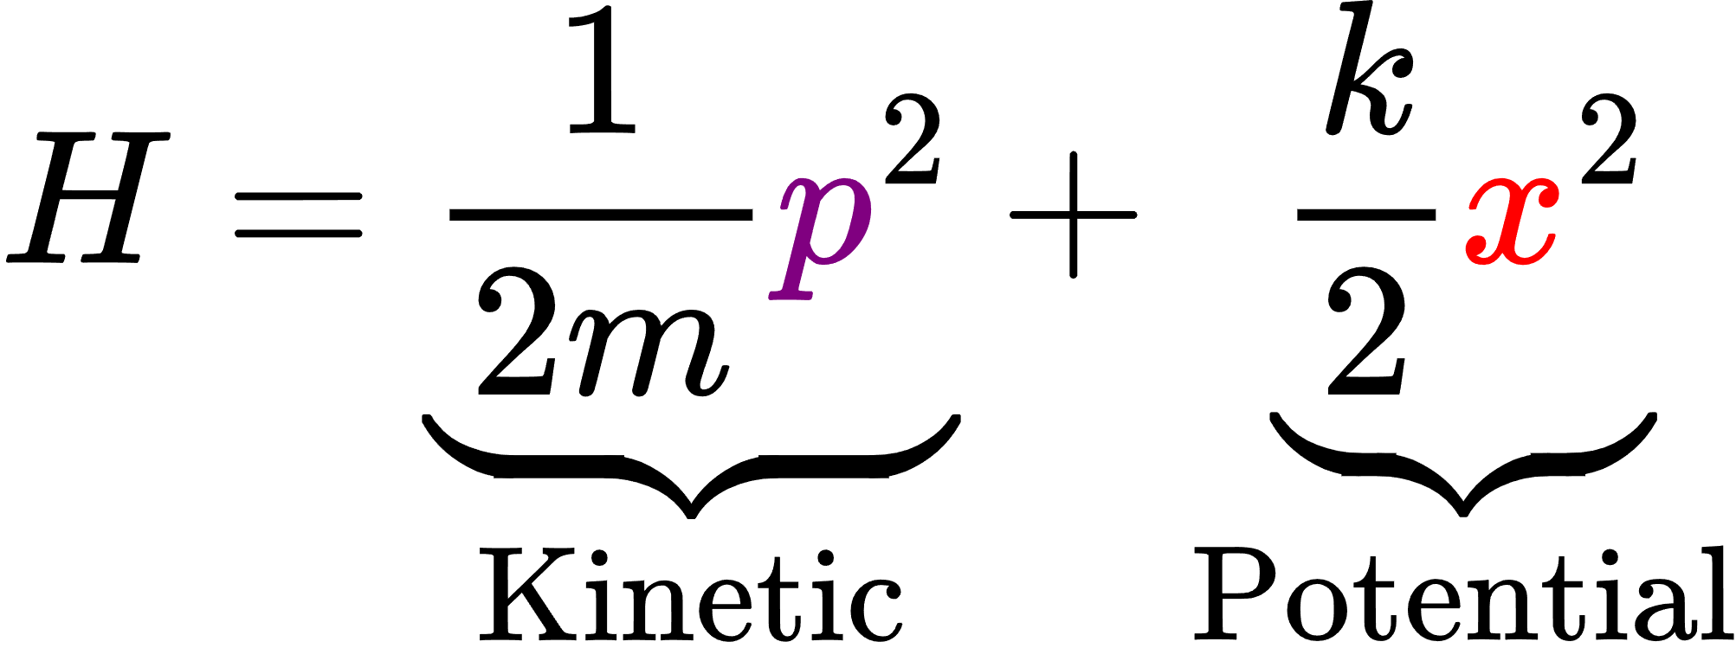
Introduction : Harmonic Oscillator
5
Blais, et al., Reviews of Modern Physics 93 (2), 025005 (2021)

Slide 6
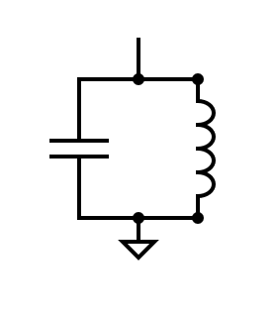
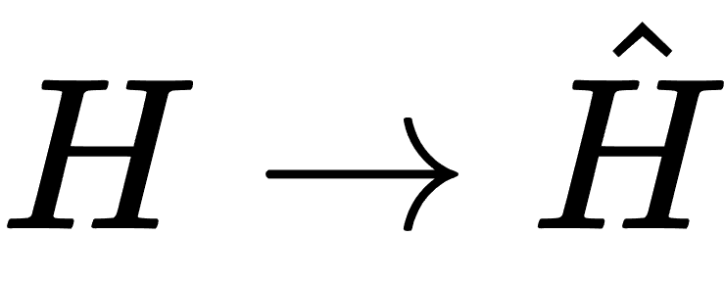
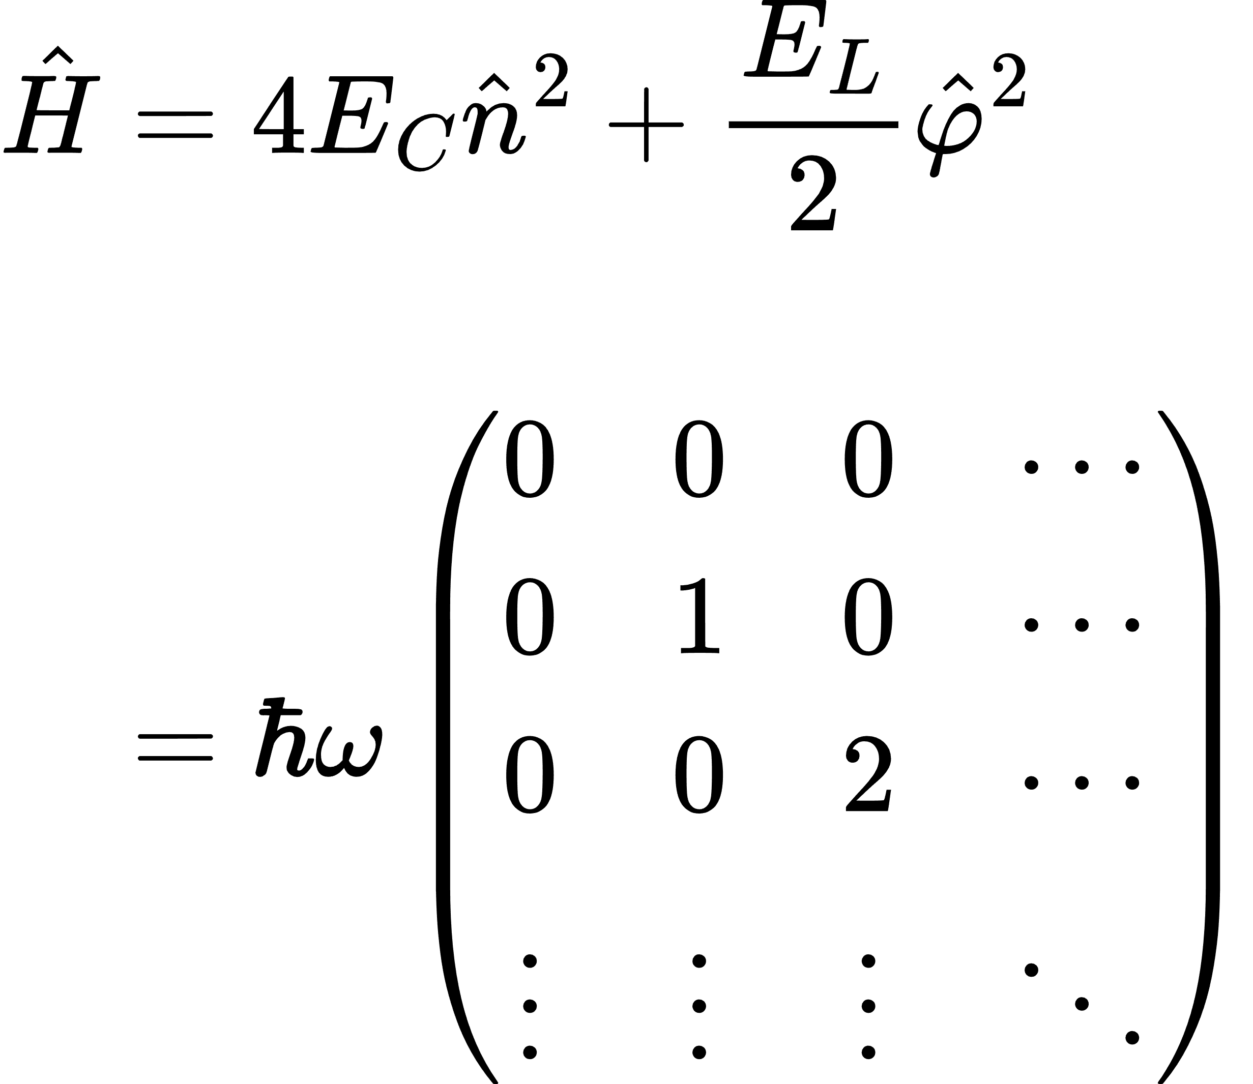
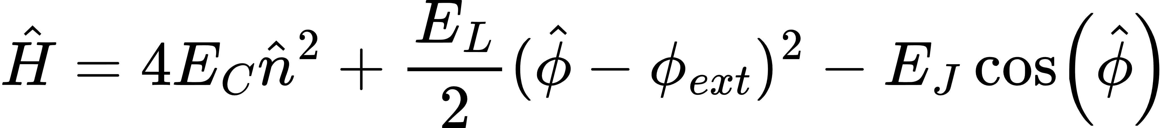
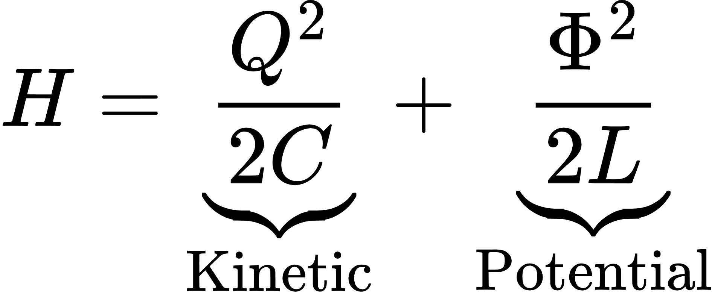
Quantizing the Harmonic Oscillator
Correspondence principle :
Operator
Hamiltonian :
6
Blais, et al., Reviews of Modern Physics 93 (2), 025005 (2021)

Slide 7
Quantizing the Harmonic Oscillator
Correspondence principle :
Operator
Hamiltonian :
Infinite basis :​
7
Blais, et al., Reviews of Modern Physics 93 (2), 025005 (2021)

Slide 8
Quantizing the Harmonic Oscillator
Correspondence principle :
Operator
Hamiltonian :
Infinite basis :​
cutoff
8
Blais, et al., Reviews of Modern Physics 93 (2), 025005 (2021)

Slide 9
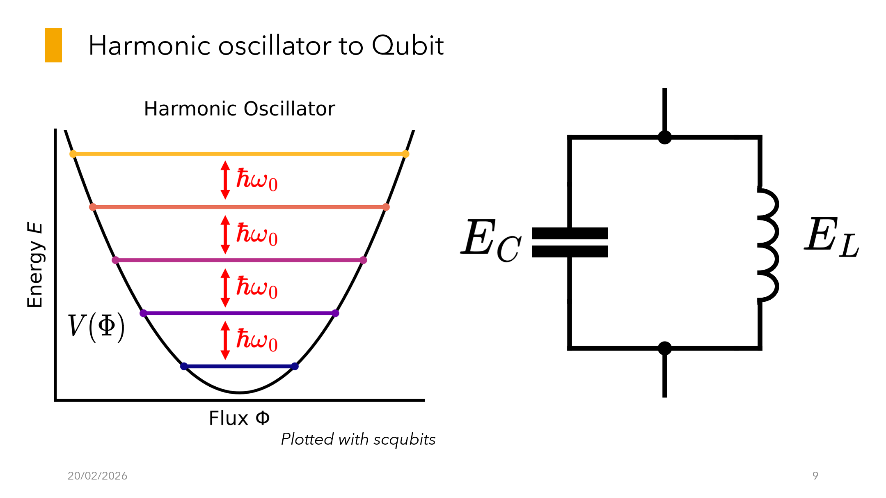

Slide 10
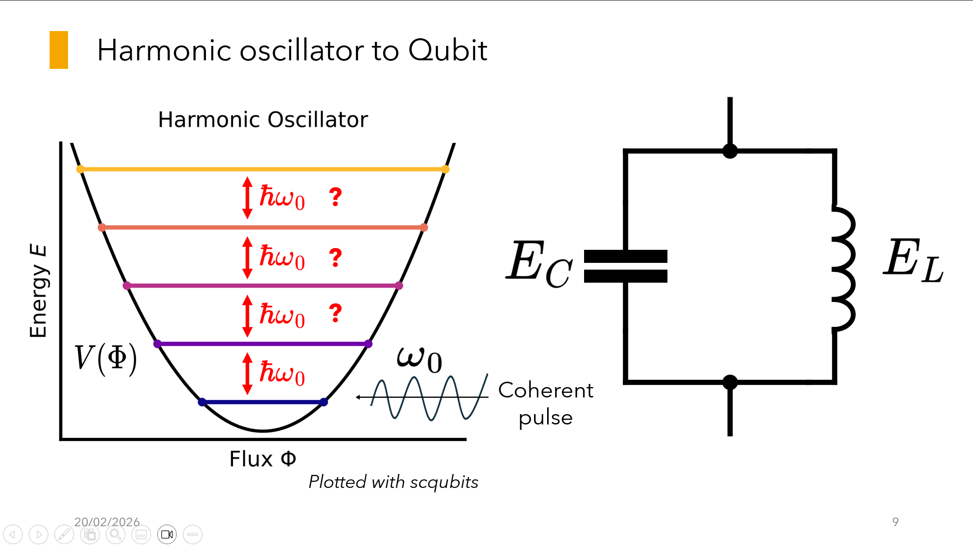

Slide 11
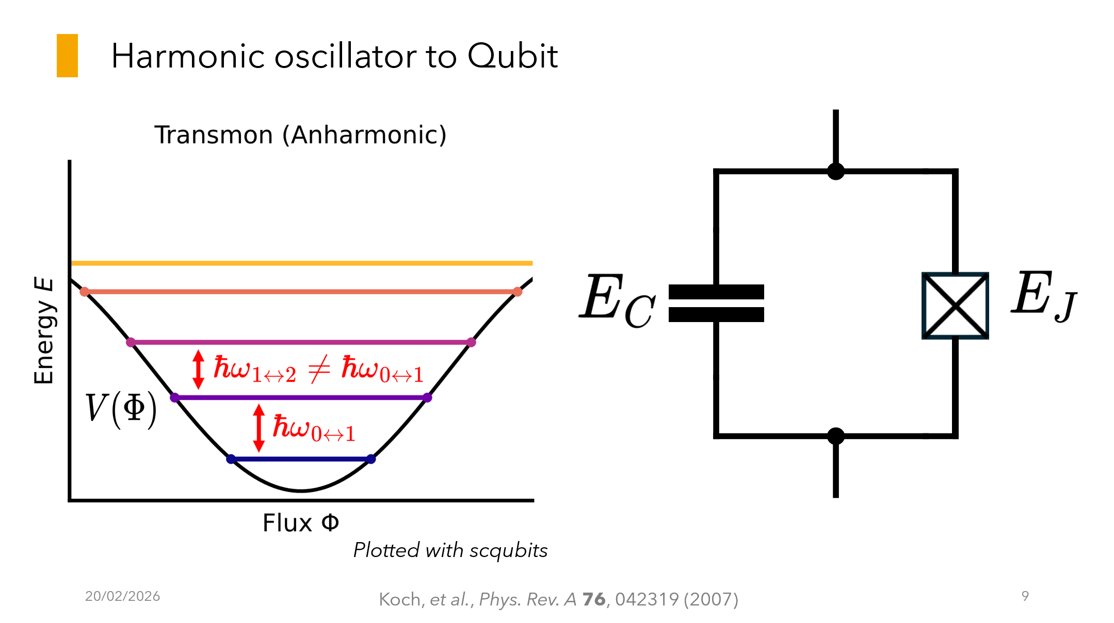

Slide 12
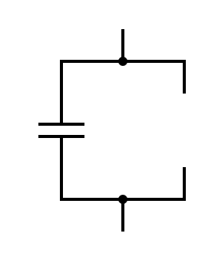
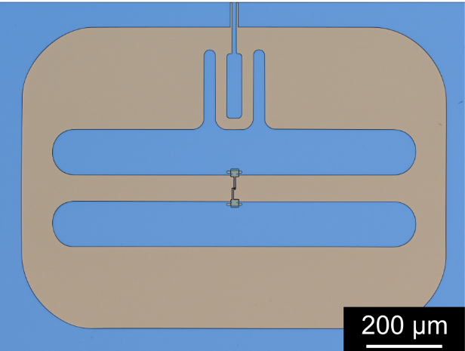

Transmon
Houck lab arXiv : 2003.00024
Koch, et al., Phys. Rev. A 76, 042319 (2007)

Slide 13
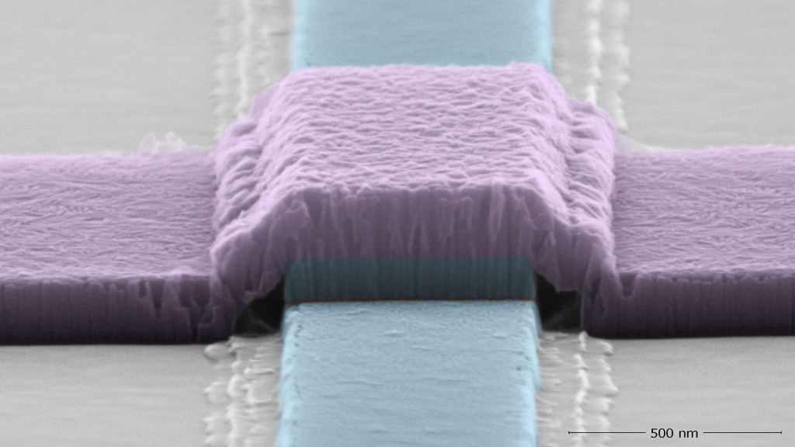

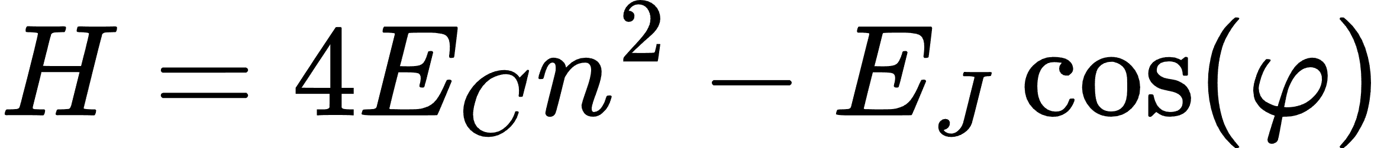
Josephson Junction
Tunnel Barrier
Superconductor
Al
AlOx
2e
2e
2e
Al
Superconductor
Source : NQISRC

Slide 14
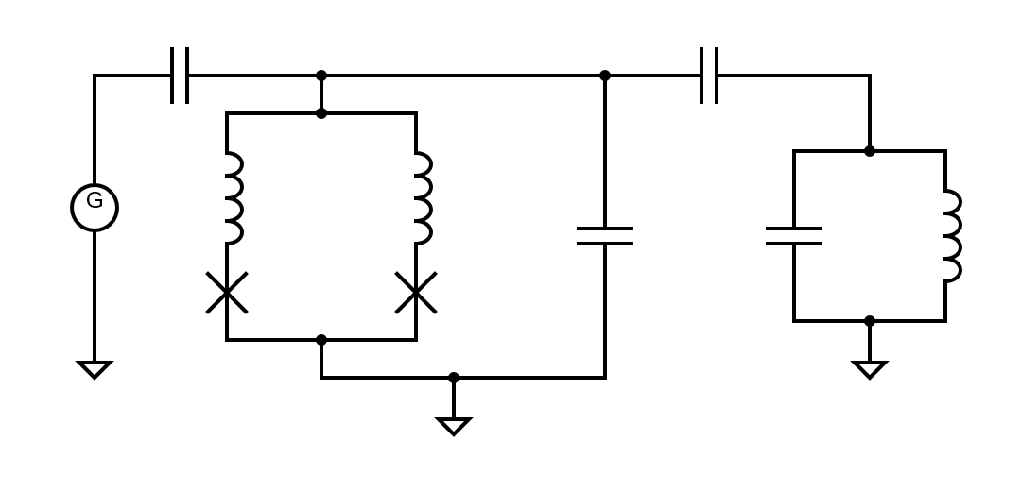
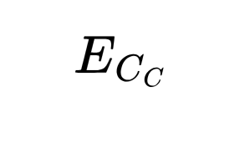
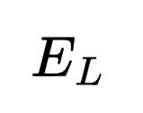
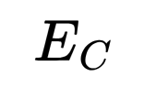

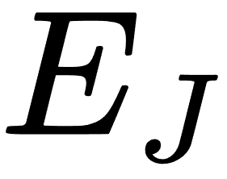
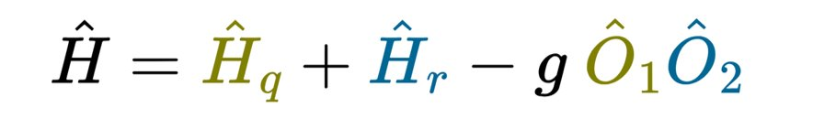
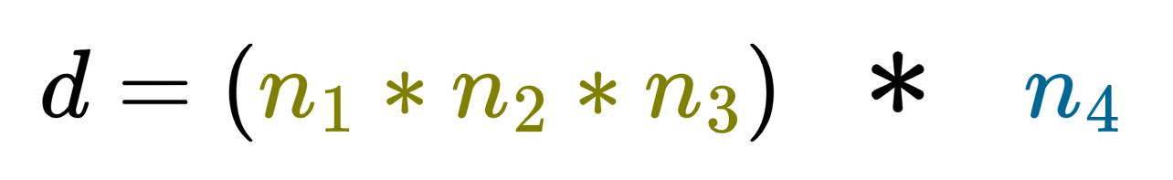
Kite Qubit
Smith, et al., Phys. Rev. X 12, 021002 (2022)

Slide 15
Kite Qubit
QUBIT
Smith, et al., Phys. Rev. X 12, 021002 (2022)

Slide 16
Kite Qubit
QUBIT (3 Modes)
Smith, et al., Phys. Rev. X 12, 021002 (2022)

Slide 17
Kite Qubit
QUBIT (3 Modes)
RESONATOR
Smith, et al., Phys. Rev. X 12, 021002 (2022)

Slide 18
Kite Qubit
QUBIT (3 Modes)
RESONATOR
Smith, et al., Phys. Rev. X 12, 021002 (2022)

Slide 19


Kite Qubit
QUBIT (3 Modes)
RESONATOR
Smith, et al., Phys. Rev. X 12, 021002 (2022)

Slide 20
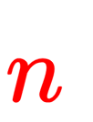
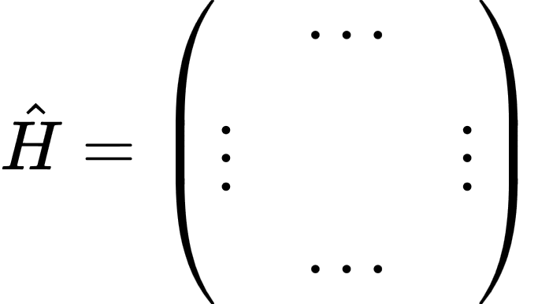
Motivations

Slide 21
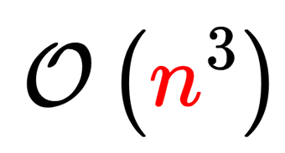
Motivations
Exact Diagonalization (ED) :

Slide 22
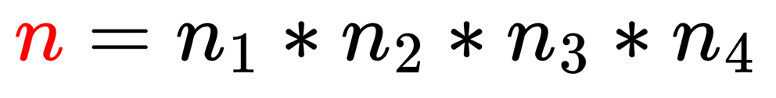
Motivations
Exact Diagonalization (ED) :
Recall that

Slide 23
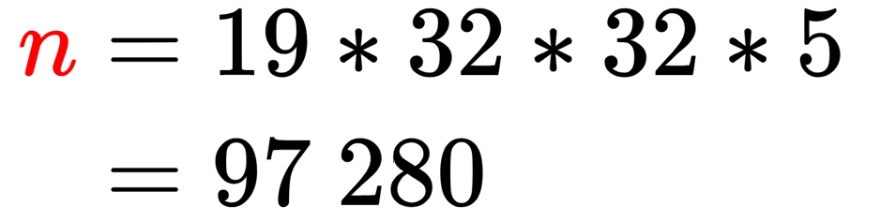
Motivations
Exact Diagonalization (ED) :
Recall that
For example,

Slide 24
Krylov Techniques

Slide 25
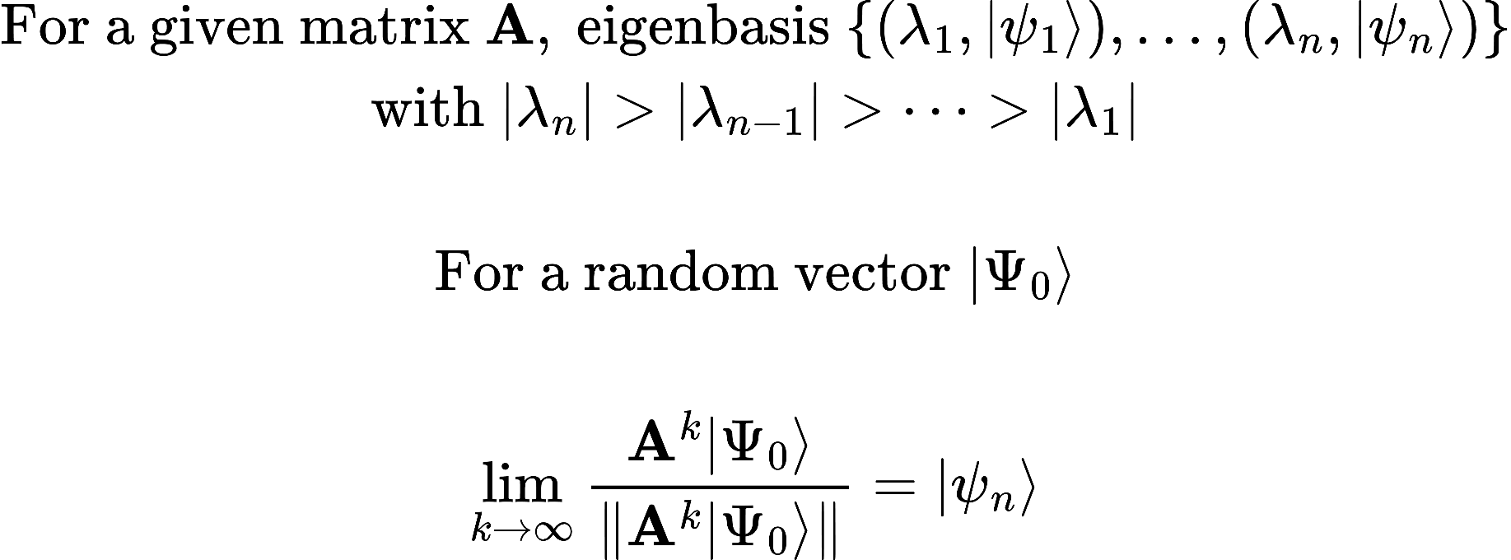
The power algorithm : Dominant Eigenspace

Slide 26
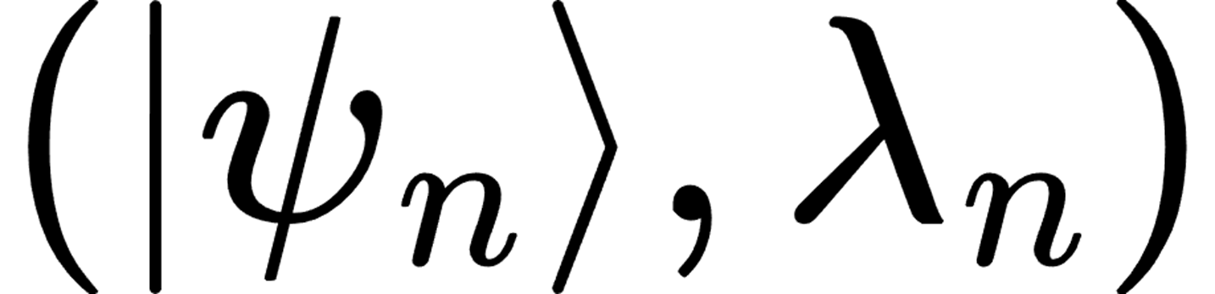
The power algorithm : Dominant Eigenspace
Power algorithm
Matrix

Slide 27
The power algorithm : Dominant Eigenspace
Power algorithm
Matrix
But : More interessed by lower energies

Slide 28
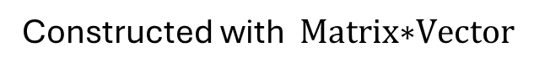
Krylov solver
Constructed with $\text{Matrix}\text{∗}\text{Vecto}\text{r}$

Slide 29
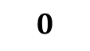
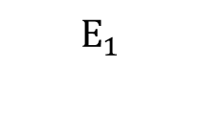

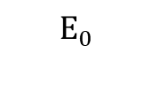
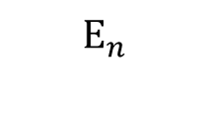


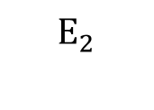
Krylov solver
Dominant Eigenvector
Constructed with $\text{Matrix}\text{∗}\text{Vecto}\text{r}$
$$E_{n}$$
$$E_{n−1}$$
$$E_{n−2}$$
Energy
$$\text{H}$$
…
$$E_{2}$$
$$E_{1}$$
$$E_{0}$$
$$0$$

Slide 30
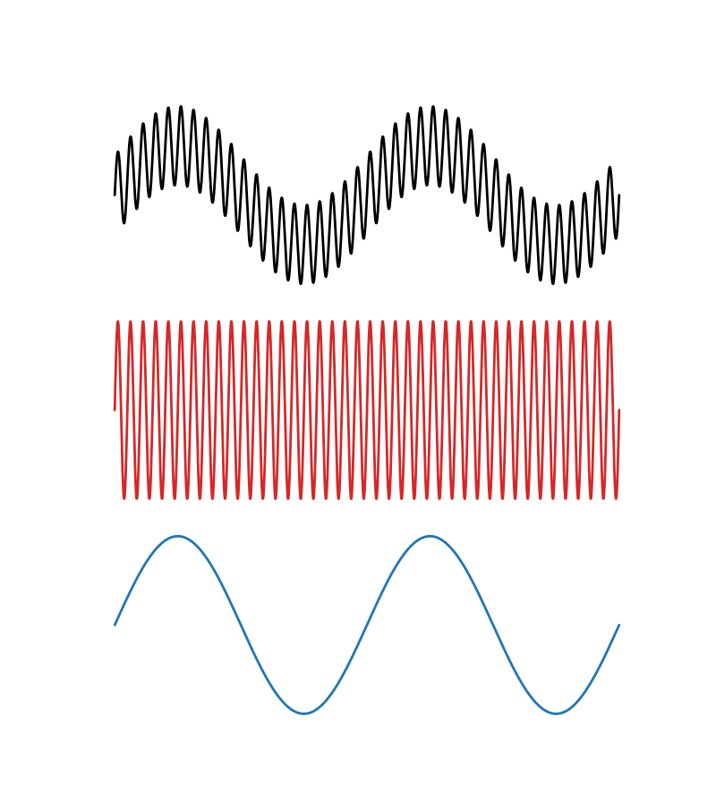
Krylov solver
Dominant Eigenvector
Constructed with $\text{Matrix}\text{∗}\text{Vecto}\text{r}$
$$E_{n}$$
$$E_{n−1}$$
$$E_{n−2}$$
-
Energy
$$\text{H}$$
…
$$E_{2}$$
$$E_{1}$$
=
$$E_{0}$$
$$0$$

Slide 31
Krylov solver
Dominant Eigenvector
Constructed with $\text{Matrix}\text{∗}\text{Vecto}\text{r}$
$$E_{n}$$
$$E_{n−1}$$
$$E_{n−2}$$
-
Energy
$$\text{H}$$
…
?
$$E_{2}$$
$$E_{1}$$
=
$$E_{0}$$
$$0$$

Slide 32
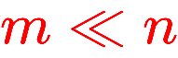
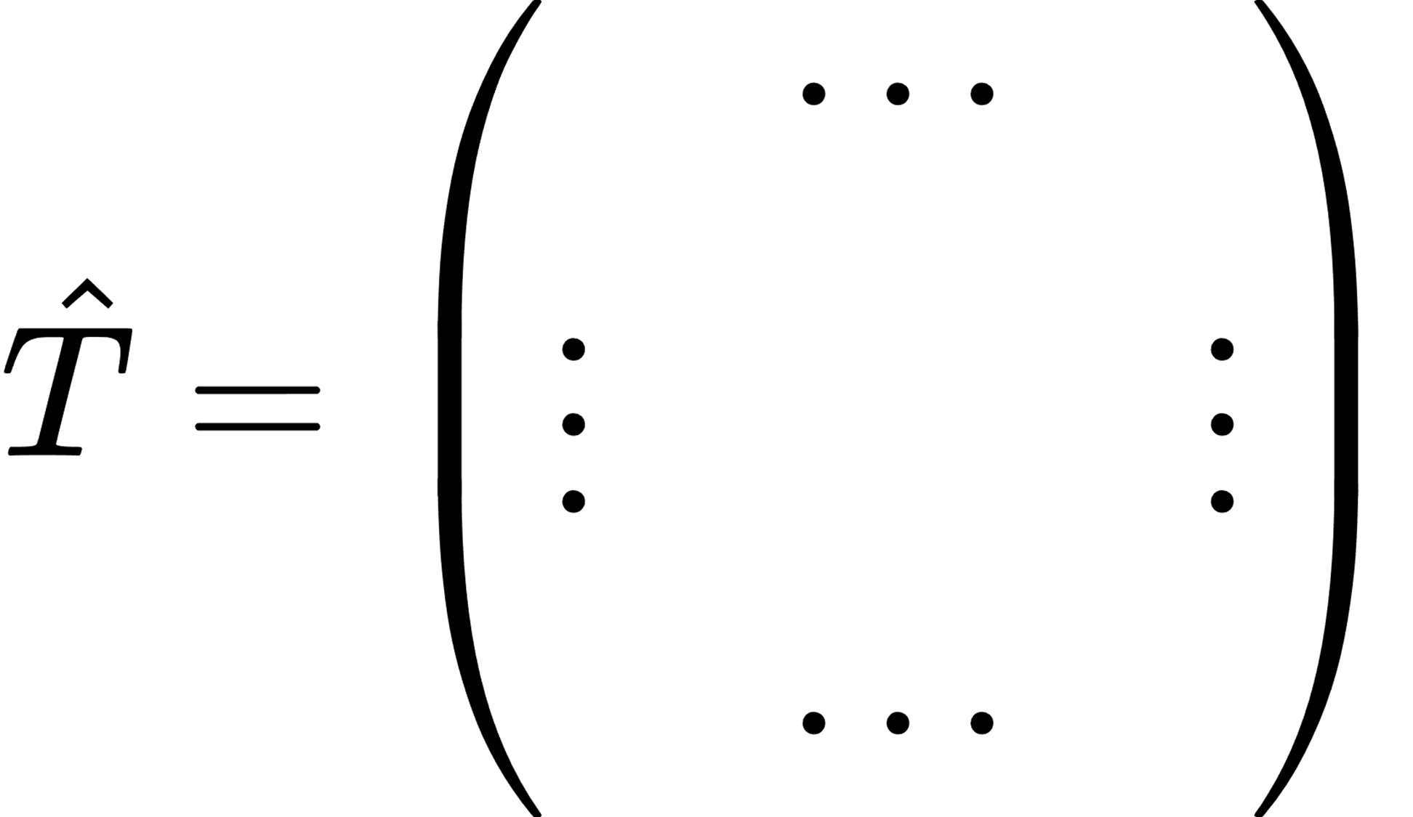

Krylov solver
Dominant Eigenvector
Constructed with $\text{Matrix}\text{∗}\text{Vecto}\text{r}$
$$E_{n}$$
$$E_{n−1}$$
$$E_{n−2}$$
-
Energy
$$\text{H}$$
…
?
$$E_{2}$$
$$E_{1}$$
=
$$E_{0}$$
$$0$$

Slide 33
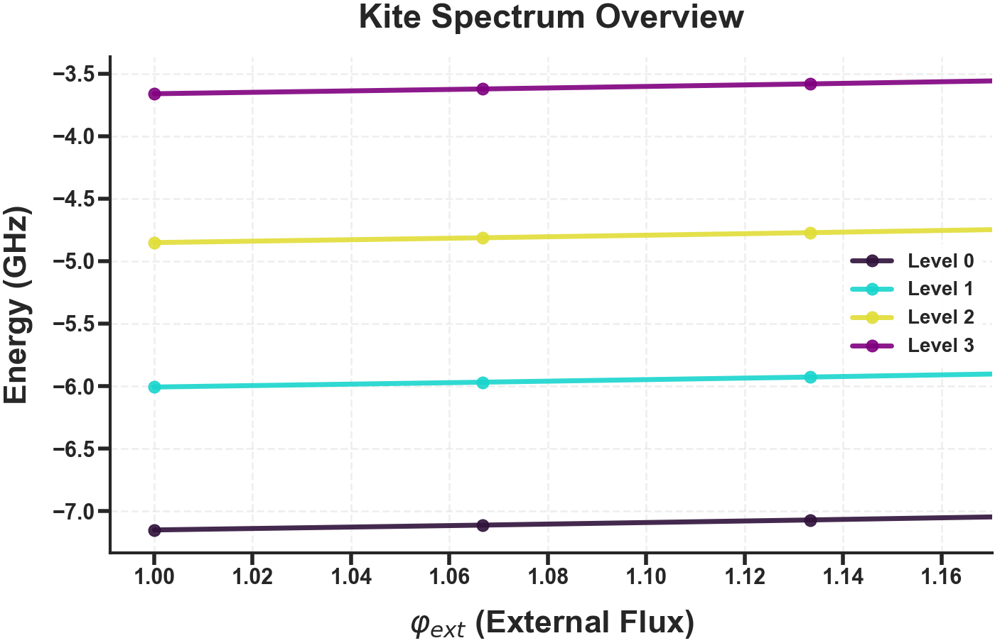
The idea

Slide 34
The idea
Lanczos computation
Aimed energy level to compute
New computation
New computation

Slide 35
The idea
Shift invert computation
Aimed energy level to compute
Using previous result

Slide 36
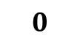


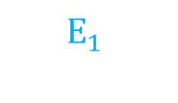
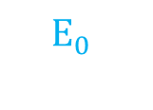
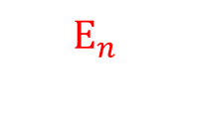
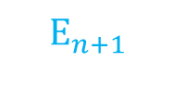
Shift Invert : conceptually
$E_{n }≃E$ : Mixed with other energies → propel it to the top of the spectrum
guess
$$E_{n+1}$$
$$E_{n}$$
Energy
$$\text{H}$$
$$E_{n−1}$$
…
$$E_{1}$$
$$E_{0}$$
$$0$$

Slide 37
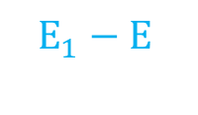
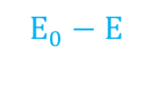





Shift Invert : conceptually
$E_{n }≃E$ : Mixed with other energies → propel it to the top of the spectrum
guess
$$E_{n+1}$$
$$E_{n+1}−\text{E}$$
$$E_{n}$$
$$0$$
$$E_{n}−\text{E}$$
Energy
$$\text{H}$$
$$E_{n−1}$$
Energy
$$\text{H}−\text{E} \text{Id}$$
$$E_{n−1}−\text{E}$$
…
…
$$E_{1}$$
$$E_{1}−\text{E}$$
$$E_{0}$$
$$E_{0}−\text{E}$$
$$0$$

Slide 38




Shift Invert : conceptually
$E_{n }≃E$ : Mixed with other energies → propel it to the top of the spectrum
guess
$$E_{n+1}$$
$$E_{n+1}−\text{E}$$
$$\frac{1}{\text{δE}}$$
$$E_{n}$$
$$0$$
$$E_{n}−\text{E}$$
Energy
$$\text{H}$$
$$E_{n−1}$$
Energy
$$\text{H}−\text{E} \text{Id}$$
$$E_{n−1}−\text{E}$$
Energy
$${\left(\text{H}−\text{E} \text{Id}\right)}^{−1}$$
…
…
$$E_{1}$$
$$E_{1}−\text{E}$$
$$E_{0}$$
$$E_{0}−\text{E}$$
$$\frac{1}{{\text{E}}_{i}−\text{E}}$$
$$0$$
$$0$$

Slide 39
Shift Invert : conceptually
$E_{n }≃E$ : Mixed with other energies → propel it to the top of the spectrum
guess
Eigenvector ?
$$E_{n+1}$$
$$E_{n+1}−\text{E}$$
$$\frac{1}{\text{δE}}$$
$$E_{n}$$
$$0$$
$$E_{n}−\text{E}$$
Energy
$$\text{H}$$
$$E_{n−1}$$
Energy
$$\text{H}−\text{E} \text{Id}$$
$$E_{n−1}−\text{E}$$
Energy
$${\left(\text{H}−\text{E} \text{Id}\right)}^{−1}$$
…
…
$$E_{1}$$
$$E_{1}−\text{E}$$
$$E_{0}$$
$$E_{0}−\text{E}$$
$$\frac{1}{{\text{E}}_{i}−\text{E}}$$
$$0$$
$$0$$
${\left(\text{H}−\text{E} \text{Id}\right)}^{−1}$ computationally hard

Slide 40
Minres algorithm

Slide 41

Minres algorithm
Solvable with Minres
Krylov Solver $AX = Y$
A invertible

Slide 42

Minres algorithm
$$\frac{1}{\text{shift}}$$
Solvable with Minres
Krylov Solver $AX = Y$
A invertible
guess + shift

Slide 43






Minres algorithm
$$\frac{1}{\text{shift}}$$
Solvable with Minres
Krylov Solver $AX = Y$
A invertible
guess + shift

Slide 44

Minres algorithm
$$\frac{1}{\text{shift}}$$
Solvable with Minres
Krylov Solver $AX = Y$
A invertible
guess + shift
First order approximation

Slide 45
Minres algorithm
$$\frac{1}{\text{shift}}$$
Solvable with Minres
Krylov Solver $AX = Y$
A invertible
guess + shift

Slide 46
Minres algorithm
$$\frac{1}{\text{shift}}$$
Solvable with Minres
Krylov Solver $AX = Y$
A invertible
guess + shift

Slide 47

Self consistency accuracy check

Slide 48

Self consistency accuracy check

Slide 49

Self consistency accuracy check

Slide 50
Self consistency accuracy check
Choose carefully shift value

Slide 51

Shift Benchmark
Follow the lower branch for different shift values
…
Variance
Overlap
Computational time

Slide 52


Shift Benchmark
Follow the lower branch for different shift values
…
Variance
Overlap
Computational time
[GHz]
[GHz]

Slide 53
Shift Benchmark
Follow the lower branch for different shift values
…
Variance
Overlap
Computational time
Numerical error
[GHz]
[GHz]

Slide 54
Shift Benchmark
Follow the lower branch for different shift values
…
Variance
Overlap
Computational time
Numerical error
Sweet
spot
[GHz]
[GHz]

Slide 55

Shift Benchmark
Follow the lower branch for different shift values
…
Variance
Overlap
Computational time
Numerical error
Sweet
spot
$$shift≃ΔE$$
[GHz]
[GHz]

Slide 56




Final benchmark
n-th eigenvalue
1 step

Slide 57

Final benchmark
Varying parameters :
n
$Δφ$
n-th eigenvalue
Benchmark metrics :
Computation time
Variance
Overlap
1 step

Slide 58


Shift invert versus Lanczos

Slide 59
Conclusion
Usefull in very specific case
Could be optimized (Minres for complex Hamiltonian)
Cannot beat Lanczos when we want several eigenvalues

Slide 60
Annex Common Part

Slide 61




Transmon
Josephson with shunted capacitor

Slide 62

Transmon : wavefunctions
Simulated with different packages
Scqbits
Qutip
Numpy

Slide 63


Fluxonium

Slide 64






Transmon Readout
Input
Output
Transmon
Resonator
More photons
Decrease readout time (+)
Increase Hilbert space (-)
2 modes

Slide 65




Cross-Kerr : Measurement
Hamiltonian in the dispersive regime, i.e. , truncated to the first two levels (Blais et al., 2004) :
Dispersive shift
Eigenstates :
Eigenvalues :

Slide 66










Maximizing overlap
?

Slide 67

Dispersive shift 𝛘 as function of detuning 𝚫
Rm : Numerical Method uses QuTiP package and Exact Diagonalisation

Slide 68

Another Method

Slide 69

Kite Qubit Hamiltonian (no assymetry)

Slide 70
Annex Eliot

Slide 71

The power algorithm : Find the dominant eigenspace

Slide 72




Shift Invert

Slide 73


Follow trajectory, shift benchmark

Slide 74



…

Slide 75



Shift invert versus Lanczos different dim

